Slide 1

Advanced Machine Learning Final Project
Team 10 : Luca LEMARCHAND, Sandrine NEANG, Amina SIALI, Hugo TERRASSE

Slide 2
Summary
Explanation of the use case, the dataset and the RNN model
Explanation of the choice of the RNN over DBM model
Demonstration of the code and the implementation
Interpretation of the results

Slide 3
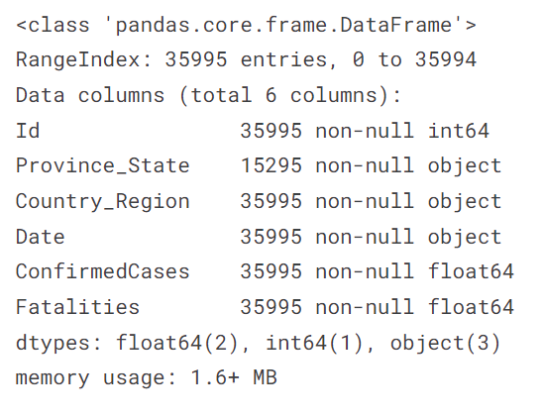
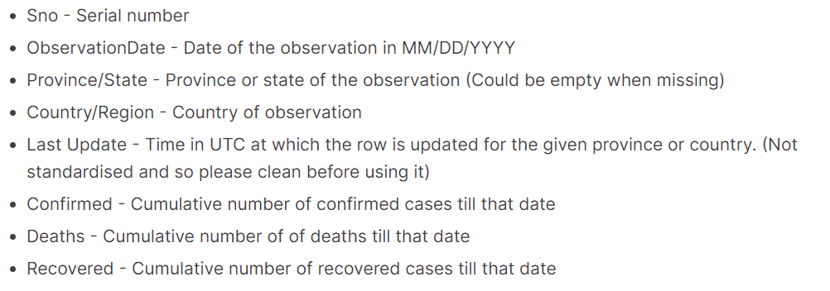
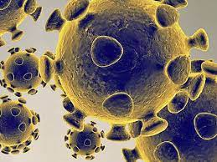
Explanation of the use case and the dataset
https://www.kaggle.com/datasets/sudalairajkumar/novel-corona-virus-2019-dataset?select=covid_19_data.csv

Slide 4
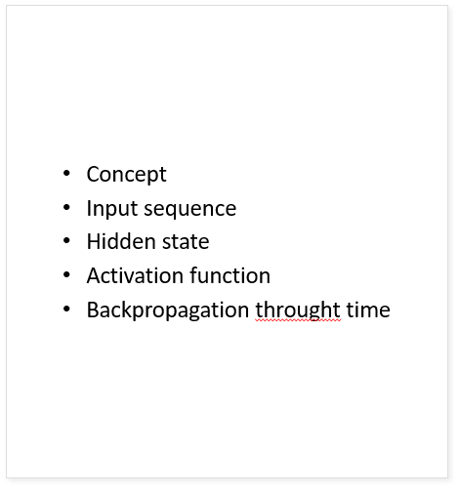
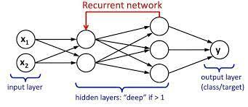
RNN model

Slide 5
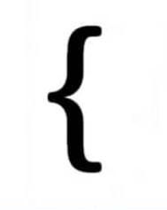
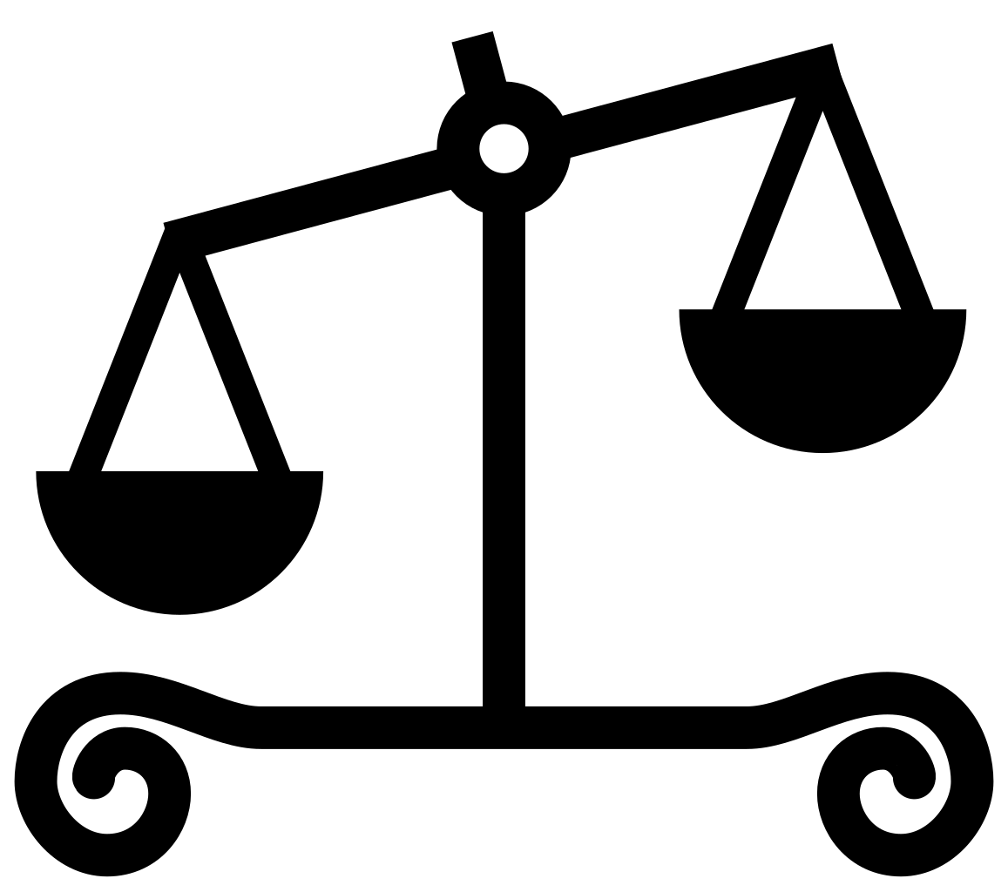
Explanation of the choice of the RNN over DBM model
RNN stands for Recurrent Neural Network
DBM stands for Deep Belief Network
Type of artificial neural network
Some advantages of using RNNs for DBM tasks :
Ability to model sequential data
Easier to train
Handling variable-length inputs
Flexibility

Slide 6

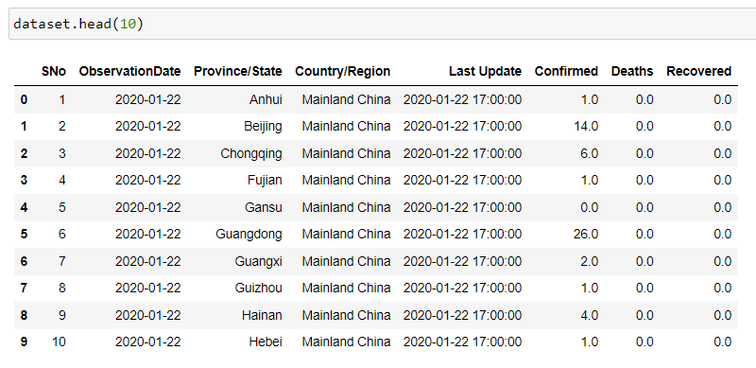
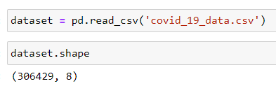

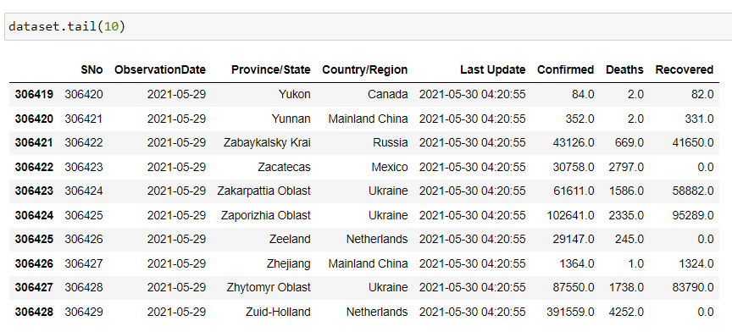
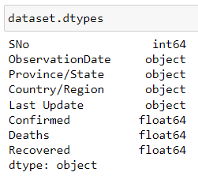
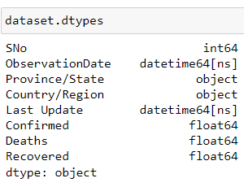
Data preprocessing
Libraries :
Importing the dataset :
Conversion variables types :
We can manipulate and analyze the date and time information more easily.

Slide 7
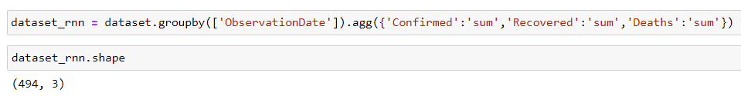
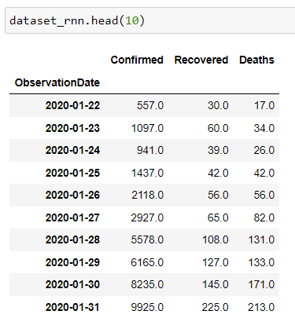
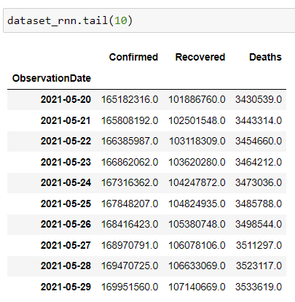


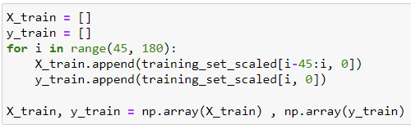
Data preprocessing for the RNN model
Dataset shape comparison : We grouped the data by dates and we adapt the dataset with only the data that are useful for the prediction.
Display of the RNN dataset :
Feature scaling, data structure & reshaping :

Slide 8
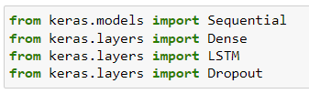
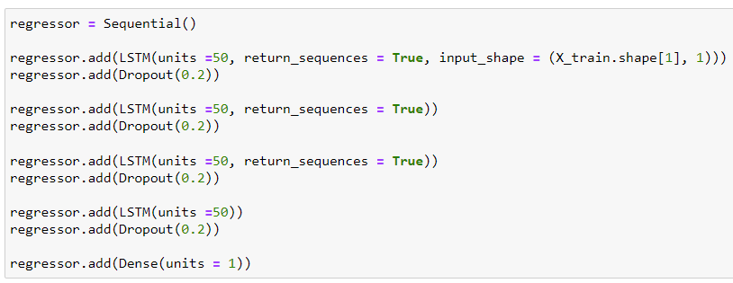

Building and training the RNN model
Libraries :
The LSTM layer has 50 neurons, and returns the entire sequence of outputs.
The Dropout layer randomly drops out 20% of the neurons during training to prevent overfitting.
Therefore, adding multiple layers of LSTM and Dropout regularization can improve the performance of the model.
Building the RNN model :
First we compile the RNN
Then, we fit the RNN to the training set in order to learn patterns and trends in the training data by adjusting the weights and biases of the network to minimize the difference between the predicted output and the actual output.
Training the RNN model :

Slide 9
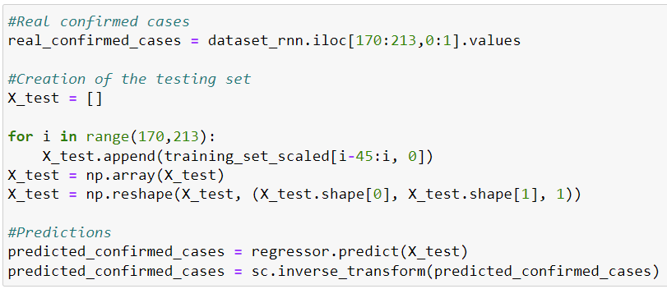
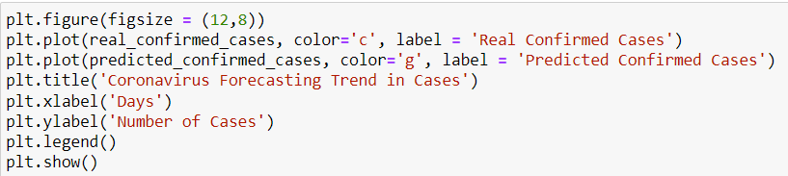
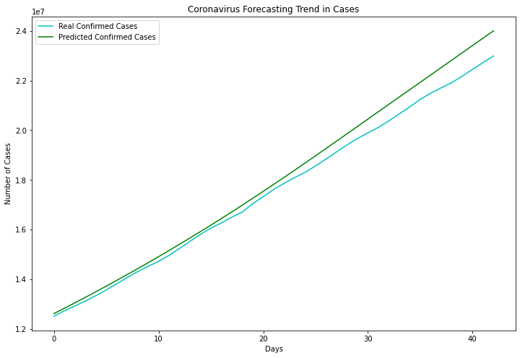
Predictions & Interpretation of the results
Making the predictions :
Visualization :
The green line is almost identical to the blue one which represent the real confirmed cases.
It shows indeed that our predictions is very accurate.
The predictions of our RNN model are quite similar to the real confirmed cases so our model is performing very well.

Slide 10
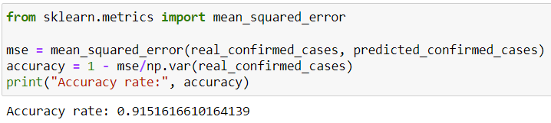
Predictions & Interpretation of the results
Performance of the RNN model :
Visualization :
We evaluated our model by calculating the accuracy rate :
We can see that our accuracy rate is very close to 1 which shows that the visualization is accurate.

Slide 11
Thank you for listening !
Team 10 : Luca LEMARCHAND, Sandrine NEANG, Amina SIALI, Hugo TERRASSE

